Slide 1
Creating a Collaborative Culture
Effective strategies for working together to answer big questions
Michael Mandel, MBA

Slide 2
Agenda
Reasons and strategies for collaboration
Building a collaboration…literally
Pyramid of Trust
Virtual Distance
Psychological Safety
PeopleStyles
The Culture Map
Ladder of Inference
Team Charters
Wrap-up

Slide 3
Why collaborate?

Slide 4
What makes collaborations work?

Slide 5
Building a collaboration. Literally.
Your collaborative task right now is to build the Lego® model in 15 minutes (or less)
Collaborations are based, in part, on combining the resources of their members – both tangible and intangible – toward common goals; for this activity, you will divide into two teams
Each team will have a different model to construct with the pieces needed to complete this task
On each team:
One person will be the coordinator, responsible for reading the build instructions and managing the team’s efforts
One person will be the assembler, responsible for executing the build instructions
The remaining team members will each own a share of the pieces and will only produce their pieces when called for by the coordinator; piece keepers may only give the assembler one type of piece at a time as instructed by the coordinator
In order to beat the clock – and the other team – you’ll all have to communicate clearly and trust each other

Slide 6
Ready…
Set…
Build!
1
15
14
2
13
3
12
Time’s Up!
4
11
5
10
6
9
7
8

Slide 7
How did it go?

Slide 8
From Dysfunctional to High-Performance
Results
Inattention to Results
Accountability
Avoidance of Accountability
Commitment
Lack of Commitment
Conflict
Fear of Conflict
Trust
Absence of Trust
Source: Lencioni, P. M. (2010). The Five Dysfunctions of a Team:
A Leadership Fable. John Wiley & Sons.
Notes:
Without trust, there is a fear that confrontation cannot be productive. Without challenging each other, the bonds of the team are weak and there is a lack of commitment. Without commitment, there is nothing to hold teammates accountable to. Without accountability, results are haphazard and often poor.
Importance of strong healthy leadership team
Qualities of a strong, cohesive leadership team
Team that “hums”
Open with one another
Passionately debate important issues
Commit to clear decisions, even if they disagree
Call each other out when behaviors or performance need correction
Focus on collective good of the organization
Pyramid of Trust (at the bottom), Conflict, Commitment, Accountability and Results
Other useful concepts – sphere of influence, sphere of interest
Pyramid of decision making --
What approaches or tools have helped you work on building and sharing leadership, and strengthening organizational health?

Slide 9

What is Culture?
Behaviors and Practices
Family
Attitudes
Media
How core values are reflected in daily interactions with others
Religion
Core Values
Learned ideas of good/bad, desirable/undesirable, acceptable/unacceptable
Culture of Origin
Institutions of Influence

Slide 10
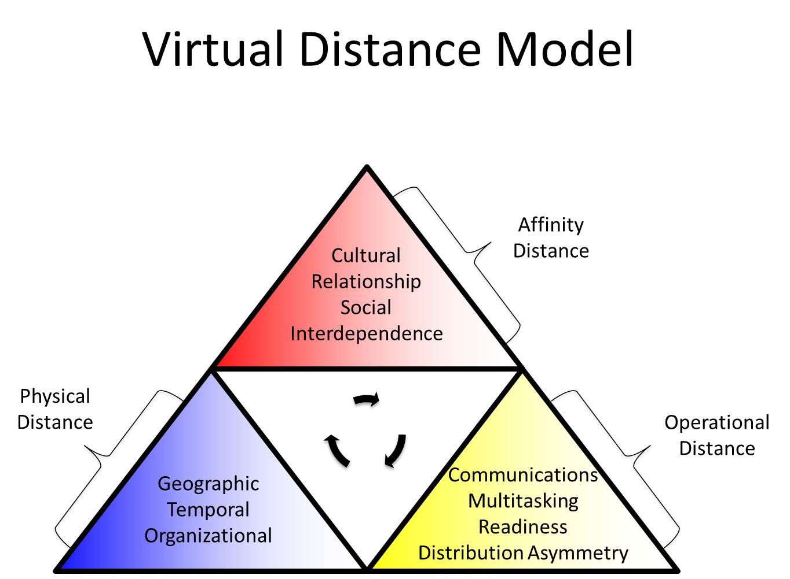
Virtual distance: How teams go wrong
Virtual Distance
Cultural Distance
Social Distance
Relationship History
Interdependence Distance
Face to Face
Multi-tasking
Technical Skill
Team Size
Geography
Time Zone
Relational Distance
Source: K. S. Lojeski, R. Reilly and P. Dominick, "The Role of Virtual Distance in Innovation and Success," System Sciences, 2006. HICSS '06. Proceedings of the 39th Annual Hawaii International Conference on, 2006, pp. 25c-25c.

Slide 11
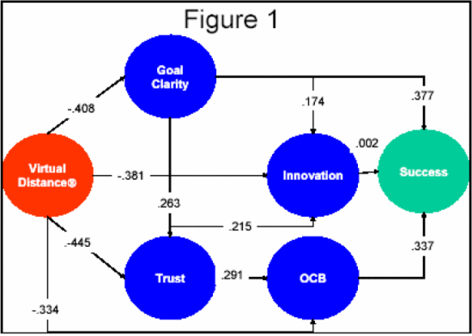
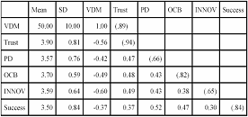
Virtual distance: How teams go wrong
Figure 1 Shows the hypothesized model with standardized path coefficients.
Table 1: Means, SDs and Correlations
All coefficients were significant (p<.01) with the exception of a non-significant path between innovation and success. The model had a good fit to the data (RMSEA=.070,CFI=.99,NFI=.973,NNFI=.96). In sum, the results showed that the VDM Index has a significant direct effect on Goal Clarity, Trust, Innovation and OCB. Goal Clarity has a significant influence on Trust, Innovation and Success. Trust has a significant direct influence on OCB and Innovation. OCB and Goal Clarity have significant direct effects on overall project success.
Source: K. S. Lojeski, R. Reilly and P. Dominick, "The Role of Virtual Distance in Innovation and Success," System Sciences, 2006. HICSS '06. Proceedings of the 39th Annual Hawaii International Conference on, 2006, pp. 25c-25c.

Slide 12
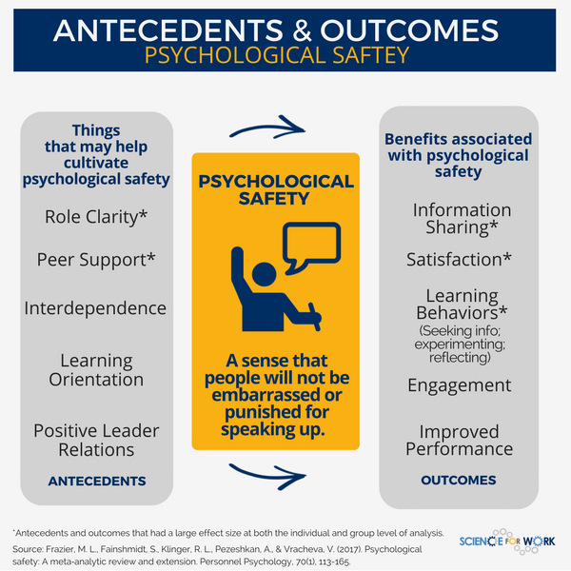

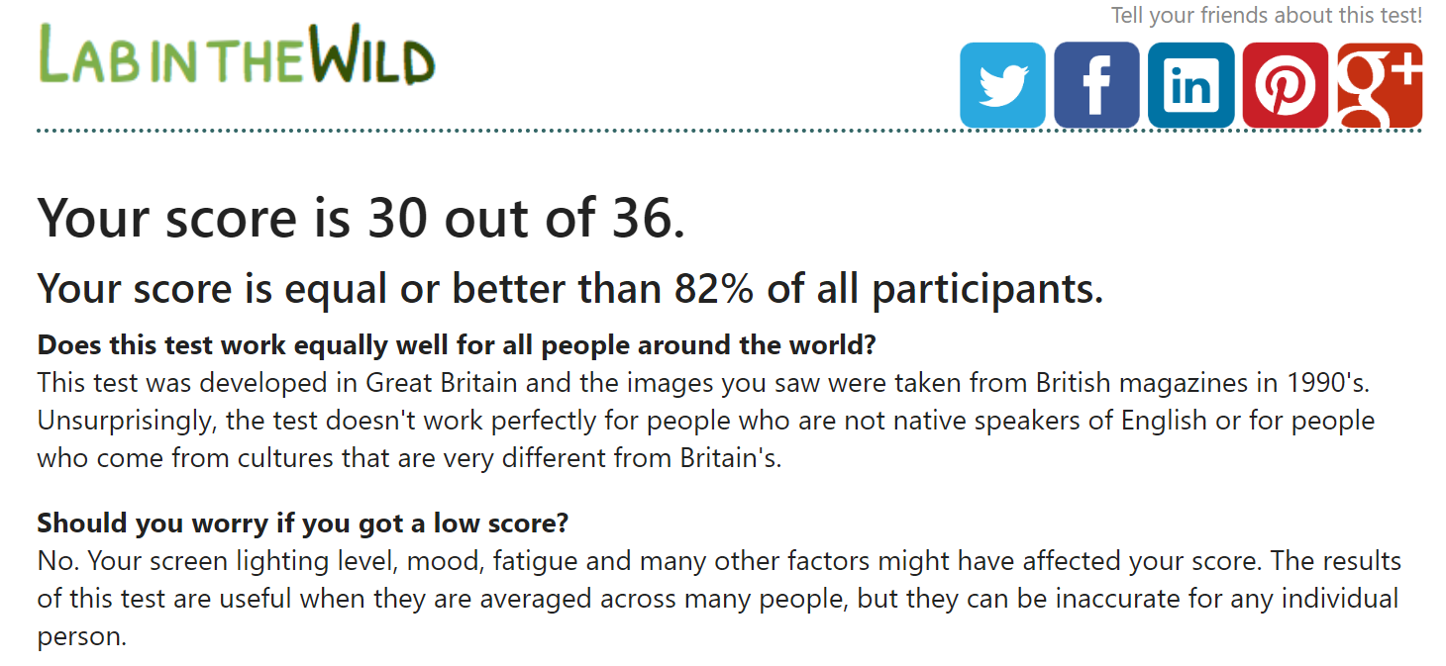
What Google Learned About Ideal Teams
*
* Spoilers: They basically just verified what the literature already said
High-functioning, effective teams foster psychological safety
“Equality in distribution of conversational turn-taking”
High social sensitivity – e.g., Reading the Mind in the Eyes test
Tolerance for risk-taking among teammates
This can be nurtured by adopting some team norms
Define a clear goal for the team
Clarify and agree to expectations for team work processes and quality
Ensure each team member understands their individual impact (starting with clear roles)
Encourage (formal or informal) socialization apart from work activities
Establish protocols to ensure no team member feels excluded
Source: New York Times

Slide 13
Psychological Safety is not…
Psychological empowerment and work engagement: refers to perceptions about one’s specific jobs or tasks
Trust: refers to one’s willingness to be vulnerable to the actions of others, to give others the benefit of the doubt
Psychological Safety, in contrast, refers to the broader work culture or environment and the perception that others will give you the benefit of the doubt

Slide 14
Specific Outcomes of Psychological Safety
Individual factor: Better task performance
Functional factor: More work engagement
Interpersonal factors
More information sharing
Organizational factors
Increased commitment
More citizenship behaviors
More creativity
More learning behaviors
Overall satisfaction
Source: Frazier, M., Fainshmidt, S., Klinger, R., Pezeshkan, A., & Vracheva, V. (2017). Psychological Safety: A Meta‐Analytic Review and Extension. Personnel Psychology, 70(1), 113-165.

Slide 15
Building Psychological Safety into your collaboration
Individual predictors
Specific “Big Five” personality traits:
Emotional Stability
Openness to Experience
Learning orientation (“fail early and often”)
Functional work predictors
Organizational predictor: supportive work context
Proactive personality
Autonomy
Interdependence
Role clarity
Interpersonal predictor: positive leader/ follower relationship
Source: Frazier, M., Fainshmidt, S., Klinger, R., Pezeshkan, A., & Vracheva, V. (2017). Psychological Safety: A Meta‐Analytic Review and Extension. Personnel Psychology, 70(1), 113-165.
Notes:
Learning happens through information sharing, which is a form of communication. “However, in order for information sharing to take place, employees must perceive that the work context provides an environment in which collaboration and feedback seeking is accepted and encouraged (Nembhard & Edmondson, 2011).”
Chicken/egg or cart/horse: you need a learning orientation to facilitate psychological safety, but you need psychological safety to engage in learning behaviors, the natural application of learning orientation.
This can lead to the framework for cultivating learning behaviors. Primarily, the ladder of inference as a structural expectation.

Slide 16
Cognitively Diverse and Psychologically Safe
Oppositional
Generative
Defensive
Uniform
Cautious
Curious
Cautious
Appreciative
Controlling
Flexible
Hierarchical
Reasoned
Resistant
Encouraging
Experimental
Forceful
Inquiring
Nurturing
Conforming
Controlling
Directive
Hierarchical
Resistant
Considered
Controlling
Competitive
Flexible
Hierarchical
Cognitive Diversity is the inclusion of people who have different approaches to responding to stimuli
High Cognitive Diversity
Assumed preferred quadrant for scientists
Psychological Safety is the shared belief that the team is safe for interpersonal risk-taking
Low Cognitive Diversity
Low Psychological Safety
High Psychological Safety
Source: Reynolds, A., & Lewis, D. (2018, April 2). The Two Traits of the Best Problem-Solving Teams. Harvard Business Review.

Slide 17
Ergo…
On existing teams, though you cannot necessarily change the team composition, you can still work to better understand existing cognitive diversity and build new systems that encourage psychological safety.
Today, we will cover several assessments and tools that will improve the effectiveness of and your satisfaction with your collaborations.

Slide 18
Collaborating Effectively
Understand existing cognitive diversity using PeopleStyles Inventory
Lay foundations for creating a psychologically safe culture using the Culture Map Assessment
Encourage psychological safety and mitigate the effects of virtual distance by using the Ladder of Inference and creating a team charter

Slide 19
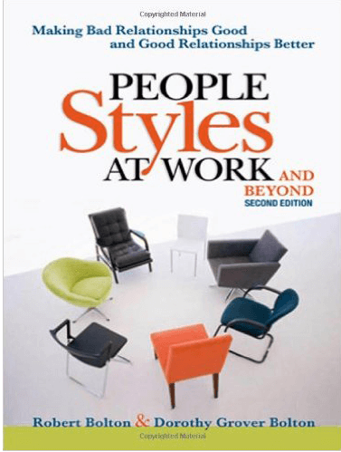
People Styles at Work Robert and Dorothy Bolton
Individual Communication and Behavioral Style

Slide 20
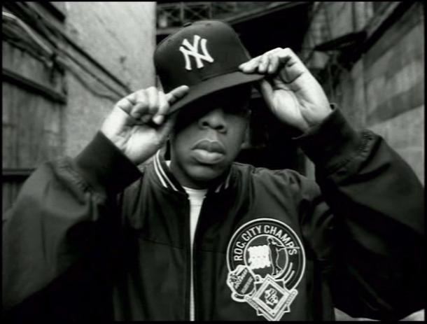
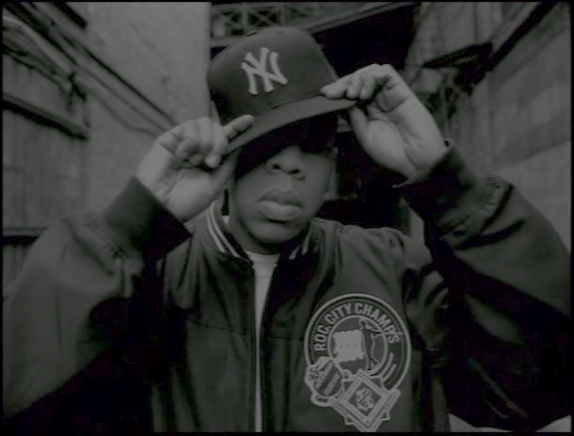
I got 99 problems…
…and most are people-related

Slide 21
We all have people problems…
You are different than approximately 75% of the population in your…
Thought process
Decision-making preferences
Work pace and style
Stress management
Behaviorally speaking, you are in the minority.
“In the 1960’s, Dr. David Merrill discovered that two clusters of behavior – assertiveness and responsiveness – are incredibly helpful in predicting how other people are apt to behave.”

Slide 22
Four Behavioral Styles
more responsive to stimuli
more social
less structured
people oriented
easy to read
looser body posture
AMIABLE
EXPRESSIVE
Dependable
Supportive
Pliable
Open
Animated
Forceful
Opinionated
Impulsive
less assertive
more assertive
talk less
ask more
indirect eye contact
use hands less
risk adverse
slower to make decisions
data driven
avoid conflict
talk more
tell more
lean forward
direct eye contact
use hands more
risk takers
decisive
hypothesis driven
fighters
ANALYTIC
DRIVER
Serious
Exacting
Indecisive
Logical
Dominating
Independent
Formal
Practical
less responsive to stimuli
more rigid body posture
hard to read
task oriented
more structured
less social

Slide 23
Analytical
Characteristics
time frame = past
process oriented
detail oriented
risk averse
structured
Motivations
data and detail
rigor
accuracy
analysis of alternatives
like to be right
Management Tactics
be accurate and rigorous
mitigate risks
think before answering
give accurate answers
survive the drilldown
provide guarantees
Motto: Let’s do it right so we don’t have to do it over.

Slide 24
Amiable
Characteristics
time frame = present
people oriented
generous with time
avoids conflict
bridge builders
Motivations
harmony
proven processes
consensus
people
Management Tactics
socialize
be empathic
provide predictable environment
mitigate risks
show proven processes
Motto: Build bridges, not walls.

Slide 25
Expressive
Characteristics
time frame = tomorrow
innovative
emotional rollercoaster
unstructured
ask for coaching
Motivations
like to look good
appreciation
spotlight
being first
influenced by status
Management Tactics
acknowledge/pay attention to
be empathic - flattery
make them the hero
don't embarrass
don't go into too much detail
Motto: Let’s have fun getting it done together.

Slide 26
Driver
Characteristics
time frame = tomorrow
decisive
challenging
structured
risk takers
Motivations
like to win
control and speed
to do's
bottom line organizer
credibility
Management Tactics
save them time
provide them options
challenge them
give quick, direct answers
Motto: Just do it!

Slide 27
Optimal Sub-Quadrants
Driver Amiable
Analytic Expressive
Expressive Analytic
Amiable Driver

Slide 28
Rigid Sub-Quadrants
Amiable
Amiable
Expressive
Expressive
Amiable
Amiable
Expressive
Amiable
Amiable
Expressive
Analytic
Amiable
Driver
Amiable
Analytic
Expressive
Driver
Expressive
Amiable
Analytic
Expressive
Analytic
Amiable
Driver
Expressive
Driver
Analytic
Analytic
Driver
Driver
Analytic
Analytic
Driver
Analytic
Analytic
Driver

Slide 29
What Is Style Flex?
Tailoring your behavior so the way you work fits better with the other people’s styles and expectations.
Change your behavior
Adjust a few actions
Adapt as needed

Slide 30
Why Flex?
It’s Strategic.
Communicators are more likely to achieve their goals if they tailor their behavior to accommodate others’ styles and expectations.

Slide 31
This Group’s PeopleStyles
Amiable
Expressive
Analytical
Driver

Slide 32
Strengths Become Weaknesses When Overused
Analytical
Prudent
Painstaking
Task-Oriented
Systematic
Indecisive
Nitpicky
Impersonal
Bureaucratic
Motto: Let’s do it right so we don’t have to do it over.

Slide 33
Strengths Become Weaknesses When Overused
Amiable
Diplomatic
Dependable
Supportive
People-Oriented
Conflict Avoider
Dependent
Permissive
Inattentive to Task
Motto: Build bridges, not walls.

Slide 34
Strengths Become Weaknesses When Overused
Expressive
Articulate
Fast-Paced
Visionary
Fun-Loving
Poor Listener
Impatient
Impractical
Distracting
Motto: Let’s have fun getting it done together.

Slide 35
Strengths Become Weaknesses When Overused
Driver
Independent
Results-Oriented
Candid
Pragmatic
Poor Collaborator
Impersonal
Abrasive
Shortsighted
Motto: Just do it!

Slide 36
Predicting Probable Behavior
Remember: no certainties – only probabilities.
Avoid labeling.
Consider other perceived factors:
Generational
Socio-economic
Gender
Cultural
Contextual

Slide 37
Four Behavioral Styles
more responsive to stimuli
more social
less structured
people oriented
easy to read
looser body posture
AMIABLE
EXPRESSIVE
Dependable
Supportive
Pliable
Open
Animated
Forceful
Opinionated
Impulsive
less assertive
more assertive
talk less
ask more
indirect eye contact
use hands less
risk adverse
slower to make decisions
data driven
avoid conflict
talk more
tell more
lean forward
direct eye contact
use hands more
risk takers
decisive
hypothesis driven
fighters
ANALYTIC
DRIVER
Serious
Exacting
Indecisive
Logical
Dominating
Independent
Formal
Practical
less responsive to stimuli
more rigid body posture
hard to read
task oriented
more structured
less social

Slide 38

The Culture Map Erin Meyer
Eight Dimensions That Define Team Cultures

Slide 39
Communicating
Measures relative preference for direct versus indirect communication.
Low-context (low number on Culture Map)
Communicates using precise, simple, explicit, and clear messages
Messages expressed and understood at face value
High-context (high number on Culture Map)
Communicates using sophisticated, nuanced, and layered messages
Reading between the lines is expected
More is left to interpretation

Slide 40
Evaluating
Measures relative preference for direct versus indirect criticism
Direct Negative Feedback (low number on Culture Map) Dispassionately gives negative feedback
Indirect Negative Feedback (high number on Culture Map) Gives negative feedback in a way that minimizes hurt feelings

Slide 41
Persuading
Measures relative preference for how one approaches persuading others
Principles-First/Deductive Reasoning (low number on Culture Map)
Provides theoretical basis first
Lays out generally accepted principles before presenting opinion or making a statement
Application-First/Inductive Reasoning (high number on Culture Map)
Provides relevant examples first
Leads with opinions or factual observations, adding concepts later to explain as necessary

Slide 42
Leading
Measures degree of respect and deference shown to authority figures
Egalitarian (low number on Culture Map) Prefers flat leadership structure
Hierarchical (high number on Culture Map) Prefers leadership structure based on rank

Slide 43
Deciding
Measures the preference for consensus versus hierarchical decision making processes
Consensual (low number on Culture Map) Prefers deciding through consensus, building group agreement
Top Down (high number on Culture Map) Prefers allowing leaders to make decisions
Notes:
Are egalitarian cultures the most consensual?
Do most hierarchical cultures expect the boss makes top-down decisions?
Not necessarily
Japanese are strongly hierarchical but have one of the most consensual cultures
Germans are more hierarchical than Americans but also more likely to make decisions through group consensus

Slide 44
Trusting
Measures degree to which trust is formed through shared work versus through shared experience
Task-based (low number on Culture Map)
From the head
Trust built through working together
I trust you because we collaborate well, and we like each other’s work
Relationship-based (high number on Culture Map)
From the heart
Builds trust through sharing down time together
I trust you because we have laughed together, have shared time relaxing together, and have come to know each other at a deep, personal level

Slide 45
Disagreeing
Measures preference for inviting versus avoiding public disputes
Confrontational (low number on Culture Map) Prefers airing grievances in public
Avoid confrontation (high number on Culture Map) Prefers keeping disagreements private or ignoring disagreements altogether

Slide 46
Scheduling
Measures preference for timing structure versus adaptability (chronemics)
Linear time (low number on Culture Map)
Prefers structured schedules and explicit deadlines
Stick to the plan and do not deviate
Flexible time (high number on Culture Map)
Prefers adapting timelines
Treats schedules as a suggestion, not a rule

Slide 47
This Group’s Culture Map
4.00
Low-Context COMMUNICATING High-Context
Direct Negative Feedback EVALUATING Indirect Negative Feedback
Principles First PERSUADING Application First
Egalitarian LEADING Hierarchical
Consensual DECIDING Top-Down
Task-Based TRUSTING Relationship-Based
Confrontational DISAGREEING Avoids Confrontation
Linear Time SCHEDULING Flexible Time
U.S. Averages

Slide 48
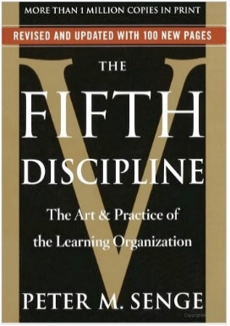
Cultivating Psychological Safety by Nurturing a Learning Organization
Climbing (down) the ladder of inference

Slide 49
How inferences are made
The reflexive loop: our beliefs affect what data we select next time
Step 6: We take actions based on our beliefs
Step 5: We adopt beliefs about the world
Step 4: We draw conclusions
Step 3: We make assumptions based on added meanings
Step 2: We add meanings to the selected data
Step 1: We select data from what is observed
Observable Data
Source: Senge, P. (1990). The Fifth Discipline: The art and practice of the learning
organization. New York: Doubleday.

Slide 50
Let’s put it into practice…
Picture it: A lab, Arizona, 2020:
Tracy enters the conference room at ten past nine to find several of her co-workers there. Dot notices that Tracy’s entrance seems unhurried. Pam notices that Tracy is wearing shorts. Don notices that Tracy does not have her briefcase with her. Kristy notices the time: 9:10 AM.
After a minute or two, Kristy insists on driving Tracy to their appointment later that afternoon.

Slide 51
Kristy and her ladder…
Take Actions: Kristy unilaterally decides the she must drive Tracy to the afternoon appointment to ensure they get there on time
Adopt Beliefs: Kristy now believes that Tracy routinely does not consider her coworkers’ time
Draw Conclusions: Kristy concludes that Tracy did not care enough about work to leave home on time
Make Assumptions: Kristy assumes Tracy is late because she did not leave home early enough to make it into the office on time
Add Meanings: Kristy adds the meaning that Tracy is late because she arrived at 9:10 AM
Select Data: Of all the observable data, Kristy chose to focus on the time, 9:10 AM
Tracy is wearing shorts
Tracy does not appear to be in a hurry
Tracy arrived at 9:10 AM
Tracy does not have her briefcase

Slide 52
What if Kristy didn’t know it all?
As it turns out, Tracy was told the meeting was to start at 9:30 and she had arrived 20 minutes early to get some other work done!
Take Actions: Kristy unilaterally decides the she must drive Tracy to the afternoon appointment to ensure they get there on time
Adopt Beliefs: Kristy now believes that Tracy routinely does not consider her coworkers’ time
Draw Conclusions: Kristy concludes that Tracydid not care enough about work to leave home on time
Make Assumptions: Kristy assumes Tracy is late because she did not leave home early enough to make it into the office on time
Add Meanings: Kristy adds the meaning that Tracy is late because she arrived at 9:10 AM
Select Data: Of all the observable data, Kristy chose to focus on the time, 9:10 AM
Tracy is wearing shorts
Tracy does not appear to be in a hurry
Tracy was told the meeting started at 9:30 AM
Tracy arrived at 9:10 AM
Tracy does not have her briefcase
Kristy was missing a valuable piece of data that would have totally changed what meaning she added, her assumptions, conclusions, beliefs, and actions! She fell off the ladder at the second rung!

Slide 53
Starting Strong and Setting the Right Tone
Laying the Foundations for Effective Collaboration

Slide 54
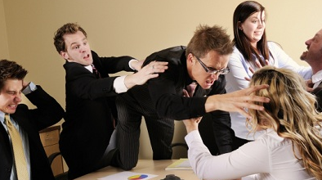

10. Scheduling conflicts
9. Assumptions about team member intentions
8. Misperceptions about team member contributions
7. Lack of clearly defined roles
6. Varying expectations about work delegation
5. Failure to hold each other accountable
4. Different standards of work quality
3. Unequal levels of commitment to course or assignments
2.
ONLY YOU CAN PREVENT COLLABORATION DUMPSTER FIRES.

Slide 55
Team Life Cycles
Team Charter

Slide 56
What can team agreements do for you?
Understand team member expectations and priorities
Quantify individual strengths and weaknesses
Cultivate respect for differing communication styles
Establish roles and operating rules
Encourage constructive conflict and prevent disruptive conflict
Make explicit commitments to each other
Lay foundations for psychological safety

Slide 57
Team Norming Conversation Starters
What do our PeopleStyles scores tell us about our communication styles?
What do our Culture Map scores tell us about our preferences around hierarchy, decision-making, conflict, and scheduling?
What strengths do we each bring to this collaboration?
How can we best leverage our strengths toward our common goals?
What commitments will we make to each other to ensure that our collaboration functions smoothly and addresses inevitable breakdowns efficiently?

Slide 58
Put it in writing
Define a clear goal for the team
Clarify and agree to expectations for team work processes and quality
Ensure each team member understands our individual impact (starting with clear roles)
Determine how we will encourage (formal or informal) socialization apart from work activities
Establish protocols to ensure no team member feels excluded

Slide 59
Common Team Roles
Task Roles
Initiator
Information giver
Socio-Emotional Roles
Encourager
Individualistic Roles
Aggressor
Information seeker
Coordinator
Critic
Recorder
Compromiser
Gatekeeper
Standard setter
Commentator
Follower
Blocker
Dominator
Evader/self-confessor
Help seeker
Recognition seeker
Playboy/girl
Special-interest pleader
Source: Walker, R. (2011). Strategic Management Communication. Stamford: Cengage.

Slide 60
Building another collaboration. Literally. Again.
After you’ve had a few days to put your charter to the test, get to know each other, and learn together, I’ll return to give you another shot at the Lego® challenge.
More to come…same bat-time, same bat-channel!

Slide 61
Wrap-up
Pyramid of Trust
Virtual Distance
Psychological Safety
PeopleStyles
The Culture Map
Ladder of Inference
Team Charters

Slide 62
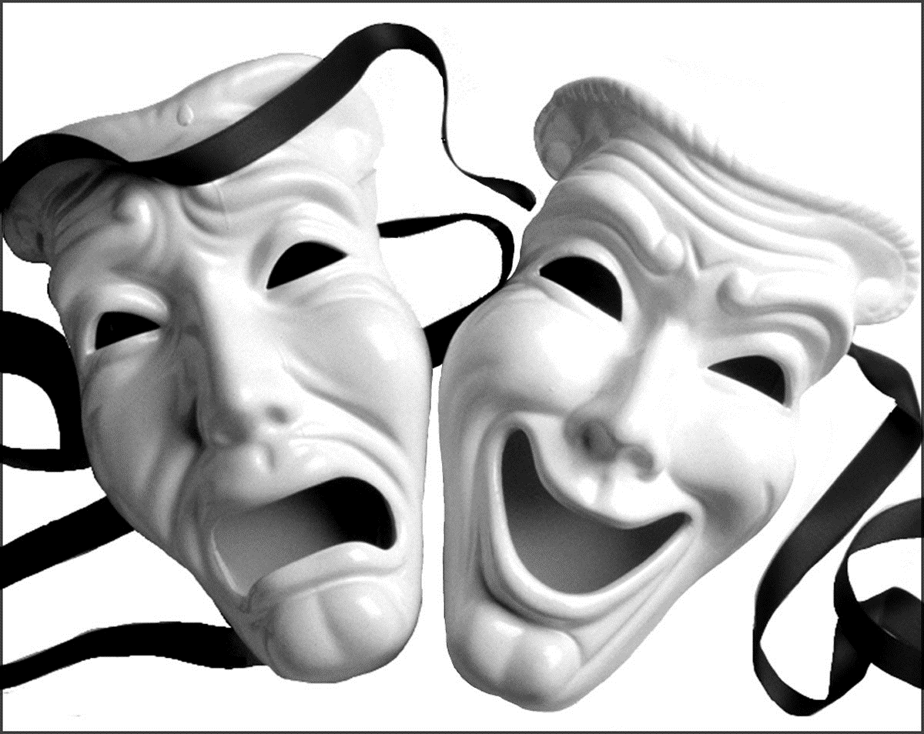
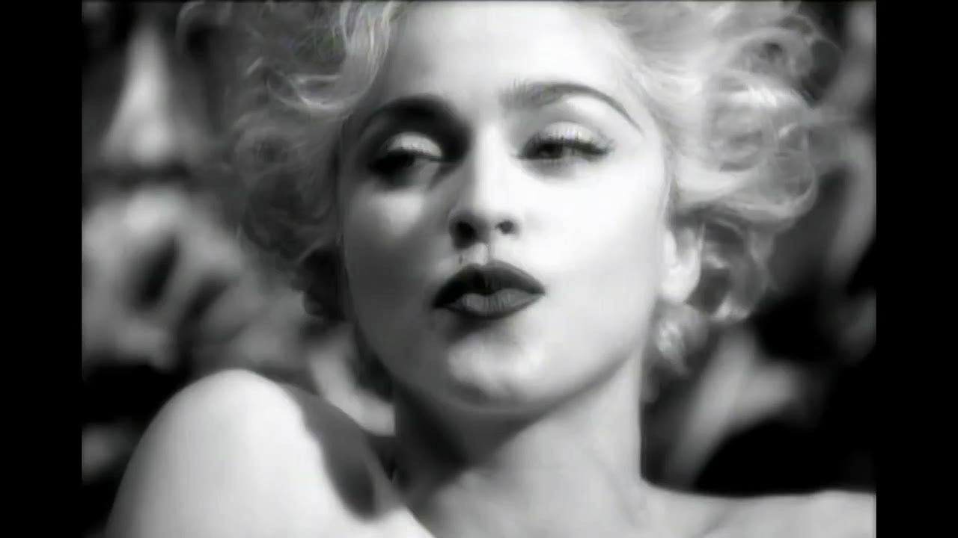
Positive Face Needs:
The desire to be well-liked and respected by others
Negative Face Needs:
The desire to be free from inconvenience or obligation
Source: Politeness: Some universals in language usage, Brown & Levinson (1987)

Slide 63
Team Best Practices
Cultivate collective competencies/ contributions
Develop and use a work plan
Select a team leader
Communicate inclusively
Produce deliverables ahead of schedule
Take notes at every meeting; conclude with action items
Practice presentations as a team
Conduct team 360° evaluations after every major deliverable
Share a common goal

Slide 64
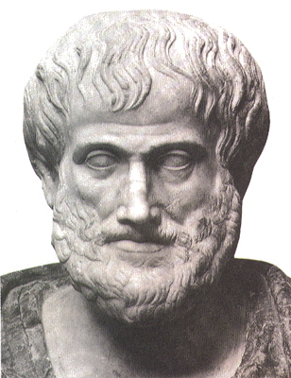
“The whole is greater than the sum of its parts.”
~ Aristotle
“For however many things have a plurality of parts and are not merely a complete aggregate but instead some kind of a whole beyond its parts…”
~ Aristotle

Slide 65
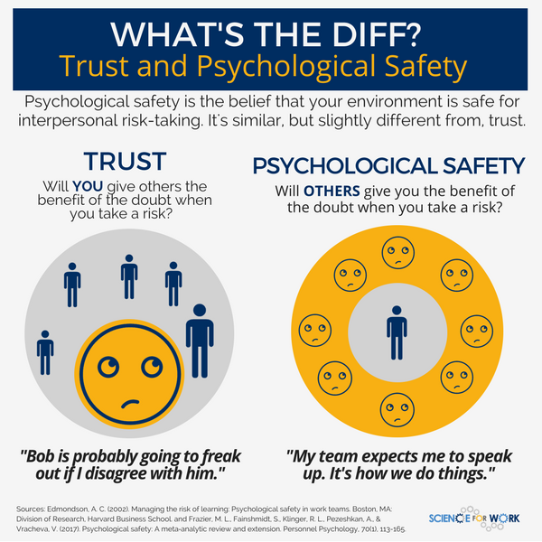
Psychologically Safe Culture
Individual Communication Style, Work Preferences, and Expectations
Individual Communication Style, Work Preferences, and Expectations
Individual Communication Style, Work Preferences, and Expectations
Individual Communication Style, Work Preferences, and Expectations
Individual Communication Style, Work Preferences, and Expectations
Individual Communication Style, Work Preferences, and Expectations

Slide 66
Processing & Decision-Making Time
Amiable
Focus on the moment – now
Slow decision making
Expressive
Future Focus
Rapid Decision Making
Slower
Faster
Analytic
Historical Focus
Slow, deliberate decision making
Driver
Future Focus
Rapid Decision Making

Slide 67
Sub Quadrants
Amiable
AMIABLE
Expressive
AMIABLE
Amiable
EXPRESSIVE
Expressive
EXPRESSIVE
Analytic
AMIABLE
Driver
AMIABLE
Analytic
EXPRESSIVE
Driver
EXPRESSIVE
Amiable
ANALYTICAL
Expressive
ANALYTICAL
Amiable
DRIVER
Expressive
DRIVER
Analytic
ANALYTICAL
Driver
ANALYTICAL
Analytic
DRIVER
Driver
DRIVER

Slide 68
Back Up Styles
ANALYTIC
avoiding
autocratic
DRIVER
autocratic
avoiding
AMIABLE
acquiescing
attacking
EXPRESSIVE
attacking
acquiescing

Slide 69
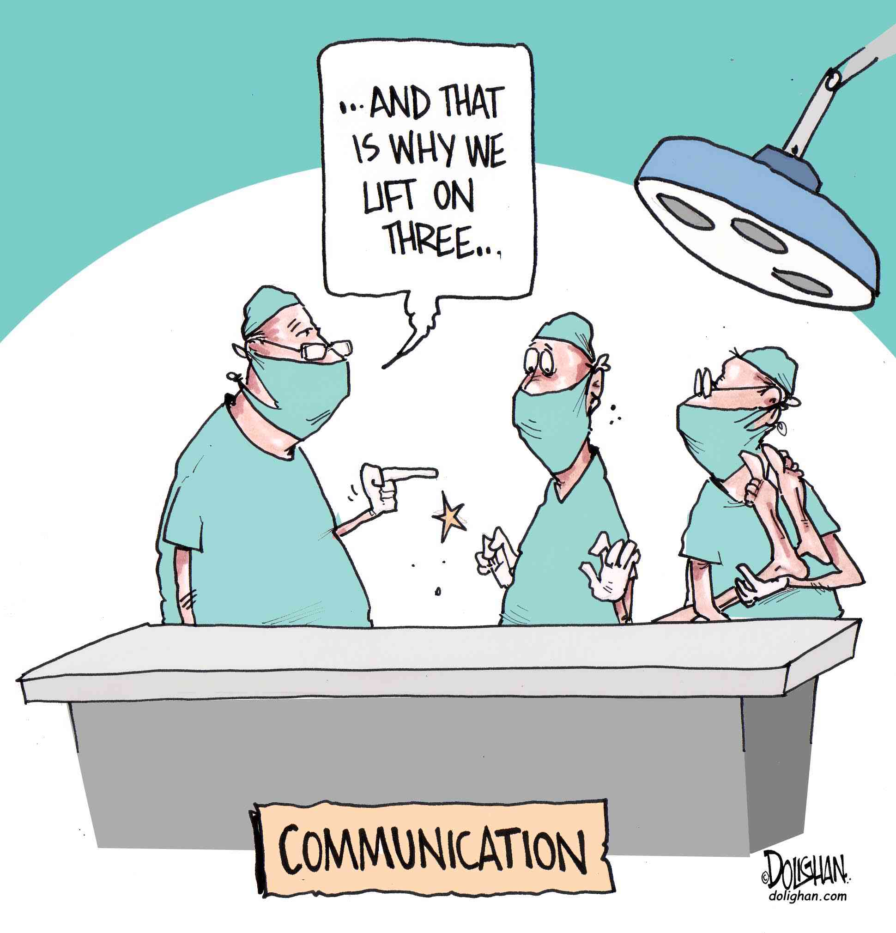
Working Through Communication Breakdowns

Slide 70
Team Charter
Breakdown
Commitment
Right/Wrong
Finger Pointing
Blame
No Coaching
Excuses/Story
Hiding/Denial
No Training
Resignation
Mind
Something is wrong with it
Something is wrong with them
Something is wrong with me
Conversation for Action
Requests & Commitments
Conversation for Opportunity
Evaluate the Possibilities
Declare a Breakdown
Restate Commitment
Conversation for Possibility
Brainstorming
Communicate
Resolve
Be Responsible
Still Committed?
No
Yes

Slide 71
Bring it together
Procedures
How will the team communicate with each other?
How will you set and follow a meeting process?
What kinds of decisions will be recorded and who will be responsible?
Will the team strictly adhere to meeting times, and deadlines, or is the team flexible?
Expectations
What are the team members’ expectations for quality of work?
What are your strategies for
Ensuring cooperation and equal distribution of tasks?
Encouraging/Including ideas from all team members?
What are your collective Culture Map preferences for:
Context/Evaluating. Low-context/direct or high-context/nuanced messaging?
Persuading. Principles- or applications-first?
Leading. Egalitarian or hierarchical?
Deciding. Consensus, majority vote, or top down decision making on team?
What builds team trust? Tasks or relationships?
Whether disagreements confrontational or private?
Personal Accountability. What are your expectations for
Attendance, punctuality, and participation?
Responsibility for completing work and meeting deadlines?
Following through on team decisions and tasks?
Consequences
What will your team do if the infractions continue? Your team will turn to this section during difficult times. Create detailed and clear processes.
Who will lead each meeting?
How will team members be notified/reminded?
Who will be responsible for the keeping the team on track during a meeting?
How would you handle infractions of any of the agreements made in this charter?
Communicating with each other?

